Slide 1


NSOP 2024
IPR #2
Air Force ROTC Detachment 842
The University of Texas at San Antonio
C/Llanas, C/Parry, & C/Griffin
8 JUL 24

Slide 2


Overview
NSOP Schedule (Draft #1)
Emails/Spreadsheets Dates
Leads/Representatives
Rooms (Reserved)
Logistics
Summary
Air Force ROTC Detachment 842 • We Build Exceptional Officers • The University of Texas at San Antonio

Slide 3
NSOP Date & Time
Aug 22nd – Main Auditorium (Cadre Led):
0700 – 0755: Leads/Volunteers Arrive for set-up
0800 – 0915: Check-in/In-Process
0920 – 0955: Commander's Intent/Questions
1000 – 1200: Cadre Introductions/Paperwork/WINGS Breakdown
1200 – 1300: Leads/Volunteers Clean up
Aug 23rd – Main Auditorium (Wing Led):
0700 – 0755: Leads/Volunteers Arrive for set-up
0800 – 0900: Check-in at Main Auditorium
0900 – 0915: Break into Groups/Flights
0915 – 1100: Rotate to different Rooms for LRS, Physicals, and Tours
1100 – 1200: Main Auditorium round up for Club Briefings (8-mins Max each), and Cadet A-Staff introductions
Prospects Dismissed
1200 – 1300: Leads/Volunteers Clean up
Air Force ROTC Detachment 842 • We Build Exceptional Officers • The University of Texas at San Antonio

Slide 4
Emails/Spreadsheets Dates
Emails:
Sports Physical
Pre-NSOP Survey
NSOP UOD
NSOP Requirements (Money/Documents)
Official NSOP Information/Parking
Slack Invitational
Week 1 Overview (PT/ASC/LLAB)
Week 1 Uniform Wear
Nurse Email
15 July 24 (Drafting)
Spreadsheets:
Cadet Check-In
Height & Weight
Required Links
Flights A-D & W-Z
GLPs (3) for FCs
9 Aug 24
Volunteers (Name, Phone Numbers, Availability, & Laptops) NLT 8 Aug 24
Air Force ROTC Detachment 842 • We Build Exceptional Officers • The University of Texas at San Antonio

Slide 5
Volunteers/Representatives
About 9 Leads
Height/Weight
Check-in
Runner
Det/MB Runner
Tour Guides
Physicals
Hallway Guide
Ushers
Public Affairs
23 August 24 (Friday) Speakers
A-Staff Representative(s))
Booster
AAS
Honor Guard
Victory
I5
Air Force ROTC Detachment 842 • We Build Exceptional Officers • The University of Texas at San Antonio

Slide 6
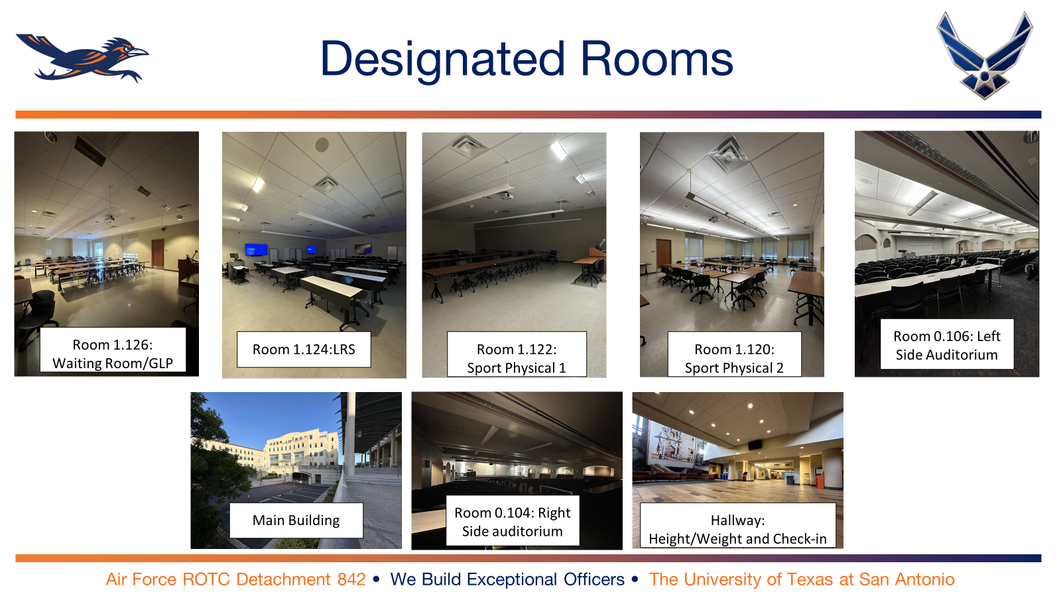
Rooms to Reserve

Slide 7
Logistics
Thursday:
Tables
Chairs
Directional Signs
Extra Paperwork
Writing utensils
Laptops
Printer
Waters/Cooler
Friday:
Height/Weight equipment
Uniforms (Polos/Det PT Shirts)
Directional Signs
Tables
Chairs
Laptops
Extra Copies (Physicals, GLPs)
Waters/Cooler
First Aid
Colored wrist bands
Air Force ROTC Detachment 842 • We Build Exceptional Officers • The University of Texas at San Antonio

Slide 8
Summary
NSOP Schedule (Draft #1)
Emails/Spreadsheets Dates
Leads/Representatives
Rooms (Reserved)
Logistics
Summary
Air Force ROTC Detachment 842 • We Build Exceptional Officers • The University of Texas at San Antonio

Slide 9
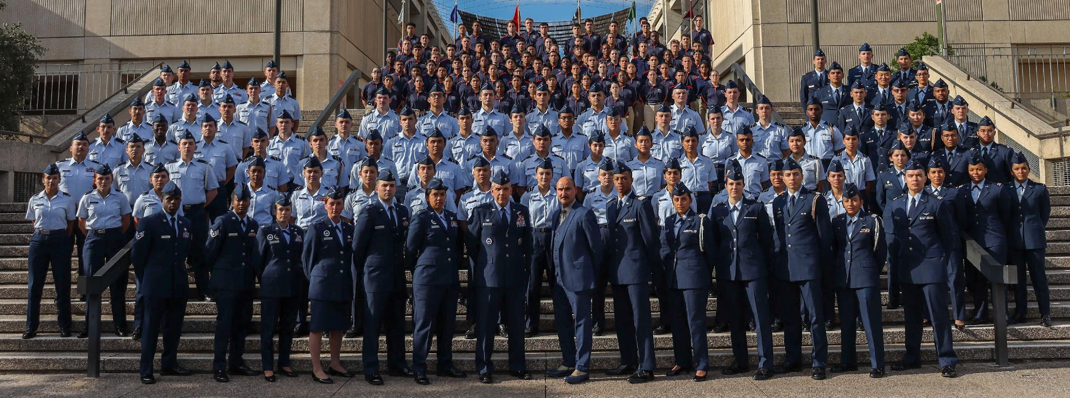
Air Force ROTC Detachment 842
The University of Texas at San Antonio
Det 842 – Best in Blue

